Slide 1
Application of Laplace Transformation in CSE
Presented By
Bishwajit Chakraborty
0242220005101414
63_I

Slide 2
What is Laplace Transformation
Laplace transform is a powerful transformation tool, which literally transforms the original differential equation into an elementary algebraic expression. This latter can then simply be transformed once again, into the solution of the original problem.

Slide 3

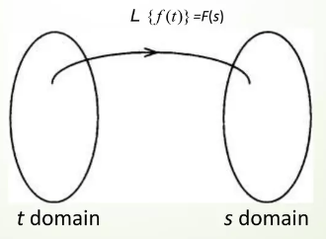
Defination of Laplace Transformation
Suppose that, f is a real or complex valued function of the
variable t > 0 and S is a real or complex parameter. We
define the Laplace transform of f as

Slide 4
Uses of Laplace Transformation
Control Systems: Laplace transforms are extensively used in the analysis and design of control systems. They help in transforming differential equations governing the behavior of systems into algebraic equations, making it easier to analyze the system's stability, time response, and frequency response.
Signal Processing: In CSE, signal processing involves analyzing, modifying, and synthesizing signals. Laplace transforms are applied to continuous-time signals to simplify differential equations representing these signals. This simplification aids in tasks like filtering, modulation, noise reduction, and system analysis.
Circuit Analysis: Laplace transforms are used in analyzing electrical circuits in both analog and digital systems. They enable engineers to study circuit behavior in the frequency domain, solving differential equations arising from circuit components and simplifying the analysis of complex networks.

Slide 5
Communication Systems: Laplace transforms are employed in analyzing communication systems' behavior, especially in modeling and analyzing the transmission and reception of signals through different channels. They help in characterizing system performance in terms of frequency response, bandwidth, and signal distortion.
Differential Equations Solving: Laplace transforms provide a method to solve linear differential equations with constant coefficients, which are common in various computational problems encountered in computer science.
System Modeling: Laplace transforms facilitate the transformation of differential equations representing system behavior into the frequency domain, making it easier to model and analyze complex systems such as software systems, networks, and distributed systems.
Digital Control Systems: In digital control systems, Laplace transforms are utilized to analyze the continuous-time models of systems, which are converted into discrete-time models using techniques like the Z-transform for implementation in digital controllers.

Slide 6
Thanks!
Do you have any questions?
Bishwajit Chakraborty
0242220005101414
chakraborty22205101414@gmail.com

